Slide 1
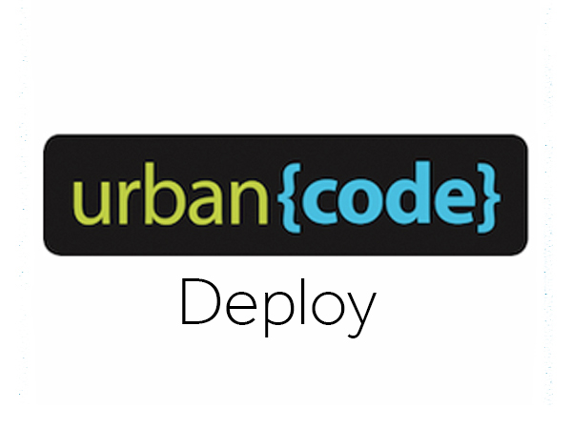
Martin George

Slide 2


Key to Continuous Delivery
Introducing UrbanCode Deploy
Component
Application
Environment
Agents
Resource
Property
Security
Licenses
UrbanCode Deploy 6.2.2
Best practices
Integrations
Demo

Slide 3

Key to Continuous Delivery Smaller more frequent releases improve quality, increase speed, and reduce risk
Small Batch Size
Small changes, implemented more frequently can reduce risk
Services: Few
Dependencies: Few
Changes: Few
Complexity: Small
Impact of Failure: Small
Failure Analysis: Simple

Slide 4
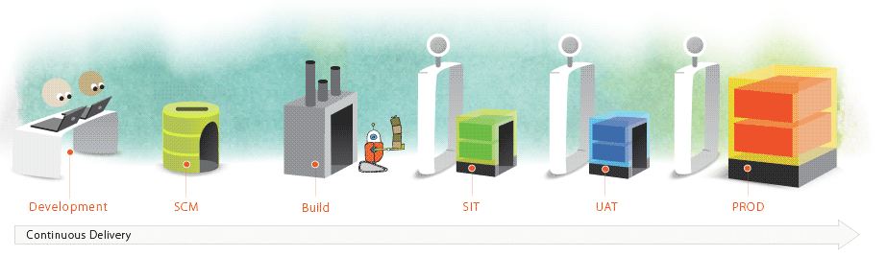
Introducing UrbanCode Deploy
Automating deployment of applications across Dev, test, and production environments
Enabling clients to more rapidly deliver mobile, cloud, big data and traditional applications with high quality and low risk
Drive down cost
Remove manual effort and wasted resource time with push button deployment processes
Speed time to market
Simple, graphical process designer, with built-in actions to quickly create deployment automation
Reduce risk
Robust configuration management, coordinated release processes, audits, and traceability
IBM UrbanCode Deploy orchestrates and automates the deployment of applications, databases and configurations into development, test and production environments, helping to drive down cost, speed time to market with reduced risk.

Slide 5
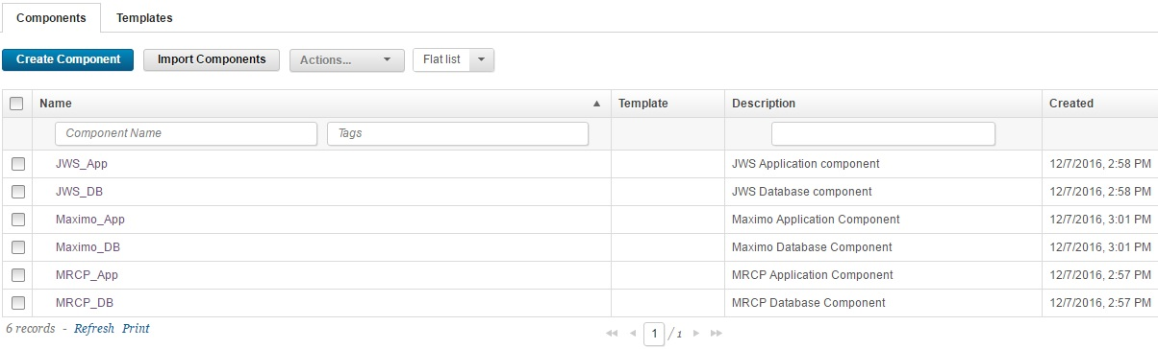
Component
Components represent deployable items along with user-defined processes that operate on them.
Deployable items, or artifacts, can be files, images, databases, configuration materials, or anything else that is associated with a software project
Artifacts can come from a number of sources: file systems, build servers, Configuration tools

Slide 6
Component processes:
A component process is a series of user-defined steps that operate on the component or its artifacts
Component processes are created with the visual drag-and-drop process editor.
Component Version:
Each time a component's artifacts are imported into the repository, including the first time, it is versioned.
Versions can be assigned automatically by IBM UrbanCode Deploy, applied manually, or come from a build server.

Slide 7
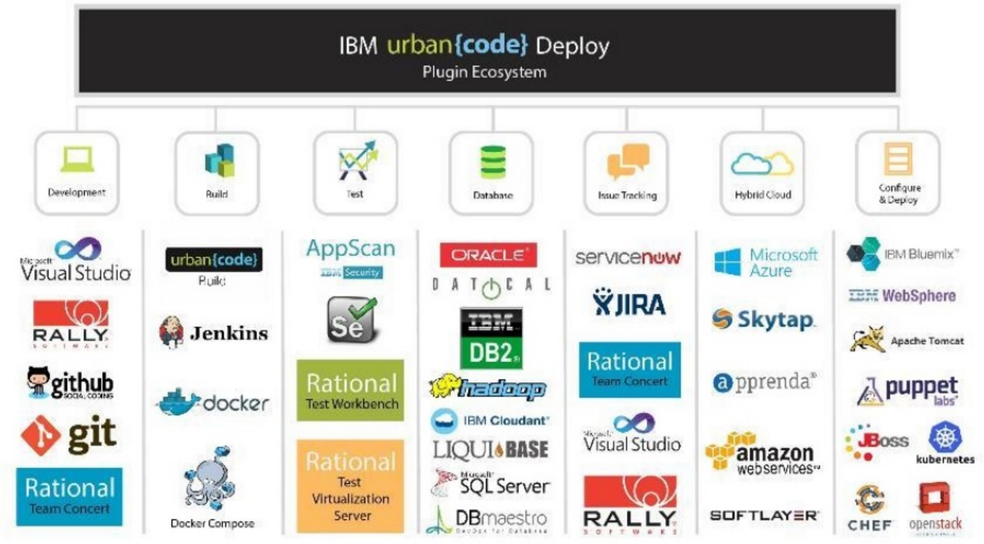
Plug-ins
IBM UrbanCode Deploy plug-ins provide tools for creating component processes and integration
Source-type plug-ins integrate with external systems to import artifacts and create component versions.
Automation-type plug-ins provide process steps that manipulate components, typically by deploying them

Slide 8
Version statuses
Component version statuses are user-managed values that can be added to component versions.
After a status is added to a version, the value can be used in component processes or application gates.
Cleaning up component versions
You can configure the server to reduce the number of component versions by archiving old versions.
You can specify global cleanup settings and cleanup settings for individual components.

Slide 9
Component templates
With a component template, you can save and reuse component processes and properties and create new components from them
Template-based components inherit the template's properties and process.

Slide 10
Application
Applications are responsible for bringing together all the components that must be deployed together.

Slide 11
Application Process
Application processes are assembled from processes that are defined for their associated components.
Application processes, like component processes, are created with the process editor.

Slide 12
Export/Import
Exporting applications creates a JSON file (file extension json) that contains the properties, components (and their associated properties and processes), and processes of the applications.
When you import applications, you can create applications or upgrade existing applications.

Slide 13
Environment
An environment is a user-defined collection of resources that hosts an application.
Environments are typically modeled on some stage of the software project lifecycle, such as development, QA, or production.

Slide 14
Environment gates
An environment gate is a requirement that must be met before component versions can be deployed to an environment.
For example, a component version might need to pass certain tests or receive an approval.

Slide 15
Snapshots
A snapshot is a collection of specific versions of components and processes.
Typically, a snapshot represents a set of component versions that are known to work together.

Slide 16
Approval process
An approval process specifies the job that needs approval and the role of the approver.
Inventory and compliance
The inventory for an environment lists the component versions that are intended to be deployed to that environment.
Compliance shows whether the environment actually contains those component versions.

Slide 17
Comparing environments
You can compare two environments to see differences in the files that they contain.

Slide 18
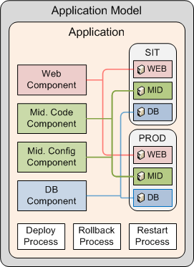
UrbanCode Deploy manages deployment of applications
Components
Tiers or services
Environments
Target servers
Environment specific configurations
Processes
Coordinates component level processes
Same processes used across environments

Slide 19
Agents
Agents play a central role in the IBM UrbanCode Deploy architecture.
An agent is a lightweight process that runs on a deployment-target host and communicates with the IBM UrbanCode Deploy server.
Communication between server and agents uses a JMS-based (Java™ Message Service) protocol.
The communication can be secured with SSL
Agent Relay
An agent relay is a communication proxy for agents that are located behind a firewall or in another network location.
Multiple agents can be connected to an agent relay.

Slide 20
Resource
A resource is a combination of component and agent.
It define what to be deployed and where to be deployed.
The resource is mapped to an environment before deployment.
Cloud connections
To provision dynamic environments from a cloud system, you must create a virtual system pattern that specifies the contents of the environment.
Helps to identify the resources on the new server at run time.

Slide 21
Property
The property specify the variables that can be set in UrbanCode Deploy.
The properties can be set for many different elements, including components, environments, processes, and applications.
To store secure values that are required for deployments artifacts, but which must remain encrypted in the user interface and logs
To provide information that differs to various environments or components
To provide property values to other processes, resources, and steps

Slide 22
Security
LDAP
The UrbanCode application are configured to authenticate with LDAP server.
The users are imported to UrbanCode Deploy from LDAP.
Users can login to the application using LDAP configured id.
Roles
A role is a collection of granted permissions.
When users are assigned to a role, they are automatically granted all permissions that are granted to the role.
Typically, the permissions that are granted to a role define a particular activity that a user might do, such as running deployment
Team
Team secure access to a UrbanCode Element.
When a team is attached to a resource ,only team members with the appropriate permissions can interact with the affected resource

Slide 23
License management
IBM UrbanCode Deploy provides a 60-day license-free evaluation period.
To use all product features after the evaluation period, you must have a license.
Server Agent:
In this scenario, the server and agents require separate licenses. The server can assign licenses to agents automatically or you can assign licenses to agents manually
Floating License Model:
When an agent runs a process, the IBM UrbanCode Deploy server retrieves a license from a license server. If the first license server does not have available licenses, the IBM UrbanCode Deploy server attempts to retrieve a license from the other license servers.
In this scenario, the IBM UrbanCode Deploy server does not require a license.

Slide 24

IBM UrbanCode Deploy 6.2.2
IBM UrbanCode Deploy 6.2.2 was released on Sep 16 and includes various bug fixes and performance enhancements. UrbanCode Deploy 6.2.2 server and agent relays require Java Runtime Environment (JRE) or Java Development Kit (JDK) version 8.
Integration with VMware vRealize:
The UrbanCode Deploy Blueprint Designer integration with vRealize Automation (vRA) enable users to provision environment on VMware vCenter and model them based on a blueprint design.
UrbanCode Deploy also allows VMware users to seamlessly move their vRA/vCenter blueprints to other cloud providers, including OpenStack, SoftLayer, and others.
Open development community:
Share anything that we build for UCD and Get to know what others are building
Share Plugins , scripts and best practices
https://developer.ibm.com/urbancode/plugins/development-community/

Slide 25
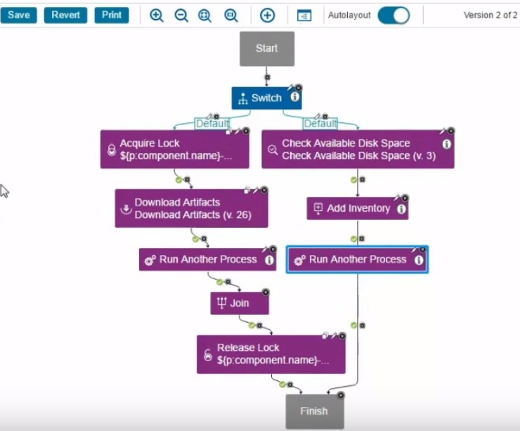
Enhanced Process editor:
The new Auto Layout feature automatically lays out the diagram when created.
Zoom to fit & Zoom to selection features are added.
The script editor have most of the features as that of a standard editor like syntax coloring , shortcuts search and replace feature etc.

Slide 26
New Jenkins pipeline plugin:
The new plug-in (Jenkins 2.0) is a Jenkins build step rather than a post-build action.
The new plugin for Jenkins Pipeline adds support for creating components, invoking UCD component imports, running steps multiple times in a single job, deploying snapshots or component version
Compatible with Jenkins Pipeline DSL
Monitoring capabilities
The new UCD version can monitor key deployment matrix
Capability leveraged by integrating with applications like New Relic or IBM APM
UCD as service
Monthly subscription.
License managed by IBM.
Service hosted on SoftLayer

Slide 27
Best practices with UCD implementation
Naming convention need to be followed for all UCD elements.
Create reusable component and application templates
Include UrbanCode Staging Environment in the solution to validating production upgrades, user training etc.
Include 1 agent relay for every 1000 Agents. Agent relay minimizes concurrent connections to the server.
Configure cleanup settings for component, audit table and resource
Plan for scheduled downtime for Upgrade/Fix packs/Patches, full backups database maintenance etc. Use maintenance mode option when needed.
Incremental backup should be happening continuously.
Plan backup and disaster recovery. Backup should include Database, Configuration Files, Code Station and patterns.
Have a failover plan. A global DNS/Load Balancer solution is generally used to cut over. IBM Support can assist in generating a duplicate copy of your production licenses to host with the disaster recovery server at no additional cost.
Include system level monitoring in the solution.

Slide 28
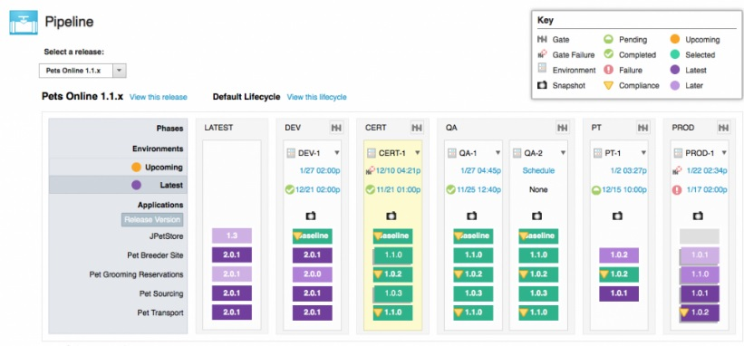
UrbanCode Deploy Integrations
Integration with UrbanCode Release help to manage complex releases. UCR helps in release planning, environment reservation, multi application release etc.

Slide 29
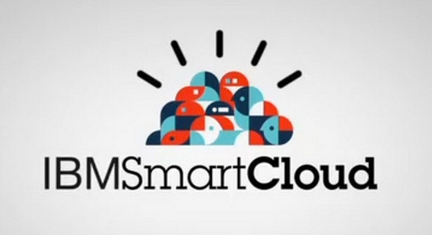
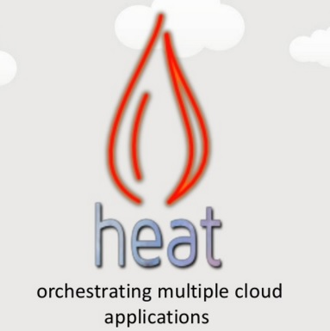



Integrating with cloud systems
Connecting to virtual system pattern-based clouds
Connecting to clouds through OpenStack Heat
Integrating with Chef
Integration with IBM products like Rational Asset Manager , Rational Test Workbench etc.
Integration using plugins.
https://developer.ibm.com/urbancode/plugins/ibm-urbancode-deploy/

Slide 30
References
http://www-01.ibm.com/support/knowledgecenter/SS4GSP_6.1.0/com.ibm.udeploy.doc/ucd61_welcome.html?lang=en
https://developer.ibm.com/urbancode/2013/11/20/pros-cons-deployment-agents/
https://developer.ibm.com/urbancode/plugins/ibm-urbancode-deploy/

Slide 31

Questions

Slide 32


Slide 33
UrbanCode Production

